Slide 1


JAVA INTERVIEW BOOTCAMP ADVANCE CONCEPTS
Lecture 16
Advance Concepts In Packages

Slide 2
CHAPTER 16
Advance Concepts In Packages
&
Access / Non-Access Modifiers
Topics Covered
Visibility Modes
Non Access Modifiers

Slide 3
Java Access Modifiers
In this section, we’ll cover all of the access modifiers—public, protected, and private—as well as default access, which is the result when we don’t use an access modifier.
We’ll also look at how we can use access modifiers to restrict the visibility of a class and its members in the same and separate packages anywhere else.

Slide 4

An Example
Examine the definitions of the classes House and Book in the following code and the UML representation

Slide 5
An Example
Here is the code:
package building;
class House {}
package library;
class Book {}
With the current class definitions, the class House cannot access the class Book. Can you make the necessary changes (in terms of the access modifiers) to make the class Book accessible to the class House?
Yes, simply declare the class Book using the access modifier public, and it’ll be accessible outside the package in which it is defined.
A top-level class can be defined only using the public or default access modifiers

Slide 6
So , what is a top level class ?
A top-level class is a class that isn’t defined within any other class.
A class that is defined within another class is called a nested or inner class.
Nested and inner classes are very much important for Java Interviews as well as learning Java 8 new features

Slide 7
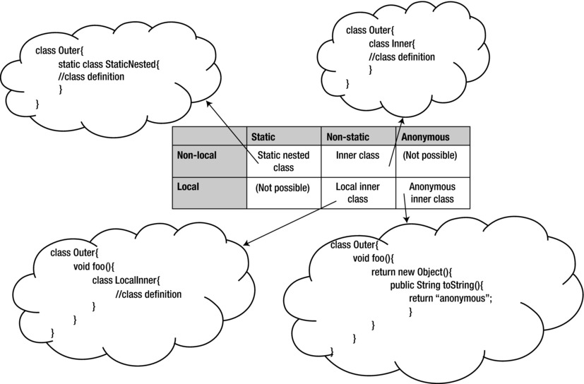
Nested Classes

Slide 8
Basic Questions On Access Modifiers
What do access modifiers control?
Access modifiers control the accessibility of a class or an interface, including it’s members (methods and variables), by other classes and interfaces.
For example, you can’t access the private variables and methods of another class.
By using the appropriate access modifiers, you can limit access to your class or interface, and their members, by other classes and interfaces.
Can Access Modifiers be Applied to All Types of Java Entities?
Access modifiers can be applied to classes, interfaces, and their members (instance and class variables and methods).
Local variables and method parameters can’t be defined using access modifiers. An attempt to do so will prevent the code from compiling.

Slide 9
Basic Questions On Access Modifiers
How Many Access Modifiers are There: Three or Four?
Java defines four access modifiers:
public (least restrictive)
protected
default
private (most restrictive).

Slide 10
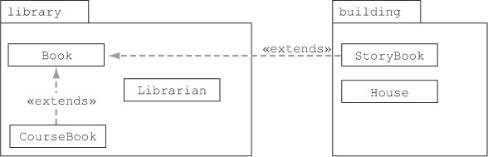
An Example
To understand all of these access modifiers, we’ll use the same set of classes: Book, CourseBook, Librarian, StoryBook, and House.
The classes Book, CourseBook, and Librarian are defined in the package library. The classes StoryBook and House are defined in the package building. Further, classes Courseook and StoryBook (defined in separate packages) extend class Book

Slide 11
public Access Modifier
This is the least restrictive access modifier.
Classes and interfaces defined using the public access modifier are accessible across all packages, from derived to unrelated classes.

Slide 12
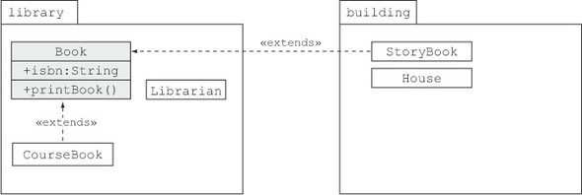
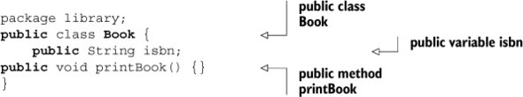
Understanding public Modifier
To understand the public access modifier, let’s define the class Book as a public class and add a public instance variable (isbn) and a public method printBook() to it
Definition of class Book:

Slide 13
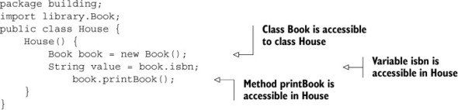
Understanding public Modifier
The public access modifier is said to be the least restrictive, so let’s try to access the public class Book and its public members from class House non parametrized constructor
Definition of class House:

Slide 14
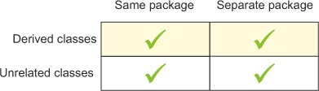
Conclusion
As we may notice in the previous example, the class Book and its public members—instance variable isbn and method printBook()—are accessible to the class House. They are also accessible to the other classes: StoryBook, Librarian, House, and CourseBook
The conclusion:

Slide 15
protected Access Modifier
The members of a class defined using the protected access modifier are accessible to
Classes and interfaces defined in the same package
All derived classes, even if they’re defined in separate packages.

Slide 16
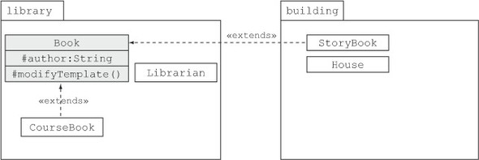

Understanding protected Modifier
To understand the protected access modifier, let’s add a protected instance variable author and method modifyTemplate() to the class Book
Definition of class Book:

Slide 17
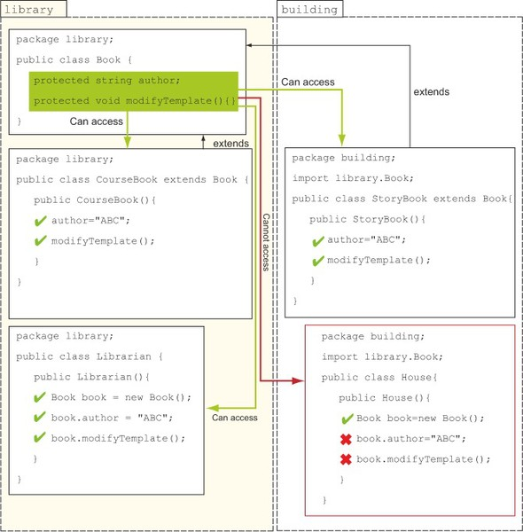
Understanding protected Modifier

Slide 18
Observations
Class House throws a compilation error message for trying to access the method modifyTemplate( ) and the variable author, as follows:
House.java:8: modifyTemplate() has protected access in library.Book
book.modifyTemplate();
^
Also notice that the derived classes CourseBook and StoryBook can access the class Book’s protected variable author and method modifyTemplate() as if they were defined in their own classes.

Slide 19
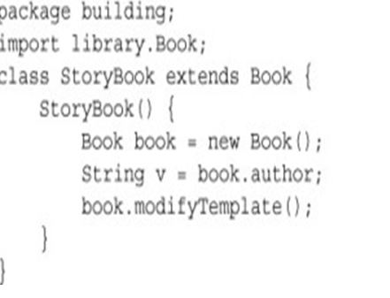
Popular Interview Question
What if class StoryBook tries to create an object of class Book and then tries to access its protected variable author and modifyTemplate()?
Answer:
It will not compile

Slide 20
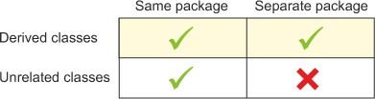
Conclusion
A derived class can inherit and access protected members of its base class, regardless of the package in which it’s defined. A derived class in a separate package can’t access protected members of its base class using reference variables.
The conclusion:

Slide 21
default Access Modifier
The members of a class defined without using any explicit access modifier are defined with package accessibility (also called default accessibility).
The members with package access are only accessible to classes and interfaces defined in the same package.

Slide 22
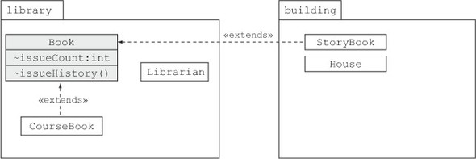

Understanding default Modifier
To understand the default access modifier, let’s define an instance variable issueCount and a method issueHistory() with default access in class Book.
Definition of class Book:

Slide 23
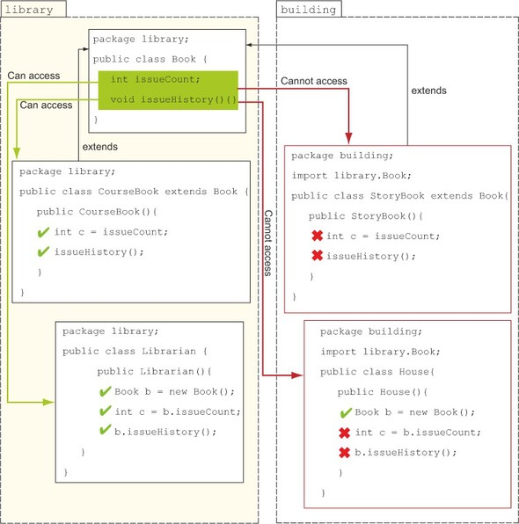
Understanding default Modifier

Slide 24
Observations
Because the classes CourseBook and Librarian are defined in the same package as the class Book, they can access the variables issueCount and issueHistory().
Because the classes House and StoryBook don’t reside in the same package as the class Book, they can’t access the variables issueCount and issueHistory().
The class StoryBook throws the following compilation error message:
StoryBook.java:6: issueHistory() is not public in library.Book; cannot be accessed from outside package
book.issueHistory();
^

Slide 25
Observations
The class House throws the following compilation error message (for trying to access issueHistory()
House.java:9: cannot find symbol
symbol : method issueHistory()
location: class building.House
issueHistory();

Slide 26
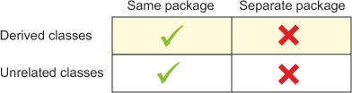
Conclusion
Default access can be compared to package-private (accessible only within a package) .
The conclusion:

Slide 27
Declaring class with default Visibility
What happens if we define a class with default access ?
a class defined with default (package) access is visible and accessible only from within the package in which it is defined.
It can’t be accessed from outside the package in which it resides.

Slide 28

Understanding default with class
Let’s redefine the class Book with default (package) access, as follows:
Definition of class Book:

Slide 29
Understanding default with class
The behavior of the class Book remains the same for the classes CourseBook and Librarian, which are defined in the same package.
But the class Book can’t be accessed by classes House and StoryBook, which reside in a separate package.
Definition of class House:
The class House generates the following compilation error message:
House.java:2: library.Book is not public in library; cannot be accessed from outside package
import library.Book;

Slide 30
Understanding default with class
Same is the case with the class StoryBook .
Here’s the code of the class StoryBook:

Slide 31
private Access Modifier
This is the most restrictive access modifier.
The members of a class defined using the private access modifier are accessible only to themselves.
It doesn’t matter whether the class or interface in question is from another package or has extended the class—private members are not accessible outside the class in which they’re defined.

Slide 32
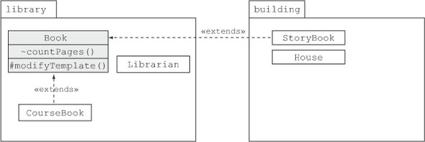

Understanding private Modifier
To understand the public access modifier, let’s define a private method countPages() to the class Book
Definition of class Book:

Slide 33

Understanding private Modifier
None of the classes defined in any of the packages (whether derived or not) can access the private method countPages(). But let’s try to access it from the class CourseBook.
Definition of class CourseBook:

Slide 34
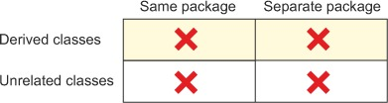
Conclusion
As we may notice in the previous example, because the class CourseBook tries to access private members of the class Book, it will not compile.
Similarly, if any of the other classes (StoryBook, Librarian, House, or CourseBook) tries to access the private method countPages() of class Book, it will not compile
The conclusion:

Slide 35
Non Access Modifiers
Access modifiers control the accessibility of your class and its members outside the class and the package.
Nonaccess modifiers change the default properties of a Java class and its members.

Slide 36
Types Of Non Access Modifiers
We can characterize our classes, interfaces, methods, and variables with the following nonaccess modifiers (though not all are applicable to each Java entity):
abstract
static
final
synchronized
native
strictfp
transient
volatile
Initially we will discuss only three of
these nonaccess modifiers: abstract, final, and static

Slide 37
The abstract Non Access Modifier
When added to the definition of a class, interface, or method, the abstract modifier changes its default behavior.
Because it is a nonaccess modifier, abstract doesn’t change the accessibility of a class, interface, or method.

Slide 38
Abstract Class
When the abstract keyword is prefixed to the definition of a concrete class, it changes it to an abstract class, even if the class doesn’t define any abstract methods.
The following code is a valid example of an abstract class:
abstract class Person {
private String name;
public void displayName() { }
}

Slide 39

Abstract Class
An abstract class can’t be instantiated, which means that the following code will fail to compile:
Here’s the compilation error thrown by the previous class:
University.java:4: Person is abstract; cannot be instantiated
Person p = new Person();
^
1 error

Slide 40
Important Tip!
An abstract class may or may not define an abstract method; we can define an abstract class without any abstract methods.
But a concrete class can’t define an abstract method.

Slide 41

Abstract Interface
An interface is an abstract entity by default. The Java compiler automatically adds the keyword abstract to the definition of an interface.
Thus, adding the keyword abstract to the definition of an interface is redundant. The following definitions of interfaces are the same:

Slide 42

Abstract Method
An abstract method doesn’t have a body.
A method with an empty body isn’t an abstract method.
Usually, an abstract method is implemented by a derived class. Here’s an example:

Slide 43
The final Non Access Modifier
The keyword final changes the default behavior of a class, variable, or method.
Final Class
A class that is marked final cannot be extended by another class. The class Professor will not compile if the class Person is marked as final, as follows:

Slide 44
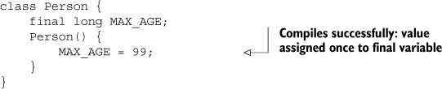
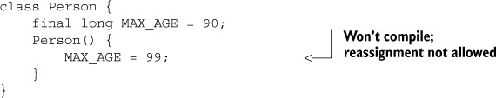
The final Non Access Modifier
Final Variable
A final variable can’t be reassigned a value. It can be assigned a value only once:
Compare the previous example with the following code, which tries to reassign a value to a final variable:

Slide 45
How the following code will behave ?
class Person
{
private final StringBuilder sb=new StringBuilder("Sa");
public Person()
{
sb.append("achin");
System.out.println(sb);
}
}
Answer:
It will successfully compile !

Slide 46
Why ?
Because If a reference variable is defined as a
final variable, we can’t reassign another object to it, but we can call
methods on this variable. So the following will be error:
class Person
{
private final StringBuilder sb=new StringBuilder("Sa");
public Person()
{
sb=new StringBuffer("Sachin"); // Error! can't assign a value to final variable
System.out.println(sb);
}
}

Slide 47
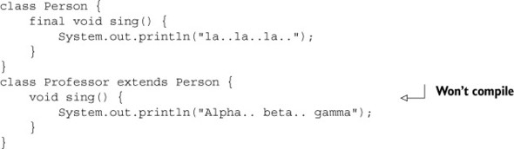
The final Non Access Modifier
Final Method
A final method defined in a base class can’t be overridden by a derived class.

Slide 48
The final Non Access Modifier
Final Interface
An interface cannot be marked as final. An interface is abstract by default and marking it with final will prevent our interface from compiling:.

Slide 49
The static Non Access Modifier
The keyword static changes the default behavior of a class, variable, interface or method.
Static Variables
Static variables belong to a class.
They are common to all instances of a class .
Static attributes may be accessed even when no instances of the class have been created.
A static variable is shared by all of the objects of a class.
A static variable can be accessed using the name of the object reference variable or the name of a class.

Slide 50

Combining static and final Non Access Modifier
The static and final nonaccess modifiers can be used to define constants (variables whose value can’t change).
In the following code, the class Emp defines the constants MIN_AGE and MAX_AGE:.

Slide 51

The static Non Access Modifier
Static Methods
static methods aren’t associated with objects and can’t use any of the instance variables of a class.
We can define static methods to access or manipulate static variables:

Slide 52
The static Non Access Modifier
Static Methods
We can also use static methods to define utility methods, which are methods that usually manipulate the method parameters to compute and return an appropriate value:
static double average(double num1, double num2, double num3)
{
return(num1+num2+num3)/3;
}

Slide 53
What can a static method access ?
Static methods cannot access the non-static variables and methods of a class.
But the reverse is true: non-static methods can access static variables and methods because the static members of a class exist even if no instances of the class exist.
static members are forbidden from accessing instance methods and variables, which can exist only if an instance of the class is created.

Slide 54
Test Your Skills(Check Multiple)
1. Given the following contents of the Java source code file MyClass.java, select
the correct options:
// contents of MyClass.java
package com.javaguru;
import java.util.Date;
class Student {}
class Course {}
A. The imported class, java.util.Date, can be accessed only in the class Student.
B. The imported class, java.util.Date, can be accessed by both the Student and Course classes.
C. Both of the classes Student and Course are defined in the package com.javaguru.
D. Only the class Student is defined in the package com.javaguru. The class Course is defined in the default Java package.
Correct Answer: B & C

Slide 55
Test Your Skills(Check Multiple)
2. Select the correct options:
A. You can start the execution of a Java application through the main method.
B. The Java compiler calls and executes the main method.
C. The Java Virtual Machine calls and executes the main method.
D. A class calls and executes the main method.
Correct Answer: A & C

Slide 56
Test Your Skills
3. A class Course is defined in a package com.javaguru. Given that the physical location of the corresponding class file is /mycode/com/javaguru/Course.class and execution takes place within the mycode directory, which of the following lines of code, when inserted at INSERT CODE HERE, will import the Course class into the class MyCourse?
// INSERT CODE HERE
class MyCourse {
Course c;
}
A . import mycode.com.javaguru.Course;
B. import com.javaguru.Course;
C. import mycode.com.javaguru;
D. import com.javaguru;
E. import mycode.com.javaguru*;
F. import com.javaguru*;
Correct Answer: B

Slide 57
Test Your Skills
4. Given the following definition of the class Course,
package com.javaguru.courses;
class Course {
public String courseName;
}
what’s the output of the following code?
package com.javaguru;
import com.javaguru.courses.Course;
class JavaGuru {
public static void main(String args[]) {
Course c = new Course();
c.courseName = "Java";
System.out.println(c.courseName);
}
}
A. The class JavaGuru will print Java.
B. The class JavaGuru will print null.
C. The class JavaGuru won’t compile.
D. The class JavaGuru will throw an exception at runtime.
Correct Answer: C

Slide 58
Test Your Skills
5. What is the output of the following program?
1: public class WaterBottle {
2: private String brand;
3: private boolean empty;
4: public static void main(String[] args) {
5: System.out.print("Empty = " + empty);
6: System.out.print(", Brand = " + brand);
7: } }

Slide 59
Test Your Skills
A.Compiler error.
B.There is no output.
C.Empty = false, Brand = null
D.Empty = false, Brand =
E.Empty = null, Brand = null
F. Exception will be thrown
Answer:A

Slide 60
Test Your Skills
6. Which of the following are true? (Choose all that apply)
4: short numPets = 5;
5: int numGrains = 5.6;
6: String name = "Scruffy";
7: numPets.length();
8: numGrains.length();
9: name.length();

Slide 61
Test Your Skills
A. Line 4 generates a compiler error.
B. Line 5 generates a compiler error.
C. Line 6 generates a compiler error.
D. Line 7 generates a compiler error.
E. Line 8 generates a compiler error.
F. Line 9 generates a compiler error.
G. The code compiles as is.
Answer: B,D & E

Slide 62
Test Your Skills
7. Given the following classes, which of the following can independently replace INSERT IMPORTS HERE to make the code compile? (Choose all that apply)
package aquarium;
public class Tank { }
package aquarium.jellies;
public class Jelly { }
package visitor;
INSERT IMPORTS HERE
public class AquariumVisitor {
public void admire(Jelly jelly) { } }

Slide 63
Test Your Skills
A. import aquarium.*;
B. import aquarium.*.Jelly;
C. import aquarium.jellies.Jelly;
D. import aquarium.jellies.*;
E.import aquarium.jellies.Jelly.*;
F.None of these can make the code compile.
Answer: C & D

Slide 64
Test Your Skills
8. Given the following classes, what is the maximum number of imports that can be removed and have the code still compile?
package aquarium;
public class Water { }
package aquarium;
import java.lang.*;
import java.lang.System;
import aquarium.Water;
import aquarium.*;
public class Tank {
public void print(Water water) { System.out.println(water); } }

Slide 65
Test Your Skills
A.0
B.1
C. 2
D. 3
E.4
F.5
Answer: E

Slide 66
Test Your Skills
9. Given the following classes, which of the following snippets can be inserted in place of INSERT IMPORTS HERE and have the code compile? (Choose all that apply)
package aquarium;
public class Water { boolean salty = false; }
package aquarium.jellies;
public class Water { boolean salty = true; }
package employee;
INSERT IMPORTS HERE
public class WaterFiller { Water water; }

Slide 67
Test Your Skills
A. import aquarium.*;
B. import aquarium.Water;import aquarium.jellies.*;
C. import aquarium.*;import aquarium.jellies.Water;
D.import aquarium.*;import aquarium.jellies.*;
E. import aquarium.Water;import aquarium.jellies.Water;
F. None of these imports can make the code compile.
Answer: A,B & C

Slide 68
Test Your Skills
10. Given the following class, which of the following calls print out Blue Jay? (Choose all that apply)
public class BirdDisplay {
public static void main(String[] name) { System.out.println(name[1]);
}
}

Slide 69
Test Your Skills
A.java BirdDisplay Sparrow Blue Jay
B.java BirdDisplay Sparrow "Blue Jay"
C.java BirdDisplay Blue Jay Sparrow
D.java BirdDisplay "Blue Jay" Sparrow
E.java BirdDisplay.class Sparrow "Blue Jay"
F.java BirdDisplay.class "Blue Jay" Sparrow
G.Does not compile.
Answer: B

Slide 70
Test Your Skills
11. Given the following class in the file /my/directory/named/A/Bird.java:
INSERT CODE HERE
public class Bird { }
Which of the following replaces INSERT CODE HERE if we compile from /my/directory? (Choose all that apply)
A.package my.directory.named.a;
B.package my.directory.named.A;
C.package named.a;
D.package named.A;
E.package a;
F.package A;
G.Does not compile.
Answer: D

Slide 71
Test Your Skills
12. Which represent the order in which the following statements can be assembled into a program that will compile successfully? (Choose all that apply)
A: class Rabbit {}
B: import java.util.*;
C: package animals;
A. B, C, A
B. C, B, A
C. B, A
D. C, A
E. A, C
F. A, B
Answer: B,C,D

Slide 72
Test Your Skills
13. Which of the following are true? (Choose all that apply)
A.Package private access is more lenient than protected access.
B.A public class that has private fields and package private methods is not visible to classes outside the package.
C.You can use access modifiers so only some of the classes in a package see a particular package private class.
D.You should use access modifiers to allow access to all methods, but not any instance variables.
E.You can use access modifiers to restrict read access to all classes that begin with the word Test.
Answer: D

Slide 73
Test Your Skills
14. Given the following my.school.ClassRoom and my.city.School class definitions, which line numbers in main() generate a compiler error? (Choose all that apply)
1: package my.school;
2: public class Classroom {
3: private int roomNumber;
4: protected String teacherName;
5: static int globalKey = 54321;
6: public int floor = 3;
7: Classroom(int r, String t) {
8: roomNumber = r;
9: teacherName = t; } }

Slide 74
Test Your Skills
1: package my.city;
2: import my.school.*;
3: public class School {
4: public static void main(String[] args) {
5: System.out.println(Classroom.globalKey);
6: Classroom room = new Classroom(101, "Mrs. Anderson");
7: System.out.println(room.roomNumber);
8: System.out.println(room.floor);
9: System.out.println(room.teacherName);
}
}

Slide 75
Test Your Skills
A.None, the code compiles fine.
B.Line 5
C.Line 6
D.Line 7
E.Line 8
F.Line 9
Answer: B,C,D,F

Slide 76
Test Your Skills
15. Which are methods using JavaBeans naming conventions for accessors and mutators? (Choose all that apply)
A. public boolean getCanSwim() { return canSwim;}
B. public boolean canSwim() { return numberWings;}
C. public int getNumWings() { return numWings;}
D. public int numWings() { return numberWings;}
E. public void setCanSwim(boolean b) { canSwim = b;}
Answer: C,E

Slide 77
Test Your Skills
16. What is the output of the following code?
1: package rope;
2: public class Rope {
3: public static int LENGTH = 5;
4: static {
5: LENGTH = 10;
6: }
7: public static void swing() {
8: System.out.print("swing ");
9: }
10: }

Slide 78
Test Your Skills
import rope.*;
import static rope.Rope.*;
public class Chimp {
public static void main(String[] args) {
Rope.swing();
new Rope().swing();
System.out.println(LENGTH);
}
}
A. swing swing 5
B.swing swing 10
C. Compiler error on line 2 of Chimp.
D. Compiler error on line 5 of Chimp.
E.Compiler error on line 6 of Chimp.
F.Compiler error on line 7 of Chimp.
Answer: B

Slide 79
Test Your Skills
17. Which are true of the following code? (Choose all that apply)
1: public class Rope {
2: public static void swing() {
3: System.out.print("swing ");
4: }
5: public void climb() {
6: System.out.println("climb ");
7: }
8: public static void play() {
9: swing();
10: climb();
11: }

Slide 80
Test Your Skills
18: public static void main(String[] args) {
13: Rope rope = new Rope();
14: rope.play();
15: Rope rope2 = null;
16: rope2.play();
17: }
18: }
A.The code compiles as is.
B.There is exactly one compiler error in the code.
C.There are exactly two compiler errors in the code.
D.If the lines with compiler errors are removed, the output is climb climb.
E.If the lines with compiler errors are removed, the output is swing swing.
F.If the lines with compile errors are removed, the code throws a NullPointerException.
Answer: B ,E

Slide 81
Test Your Skills
19 .How many compiler errors are in the following code?
1: public class RopeSwing {
2: private static final String leftRope;
3: private static final String rightRope;
4: private static final String bench;
5: private static final String name = "name";
6: static {
7: leftRope = "left";
8: rightRope = "right";
9: }
10: static {
11: name = "name";
12: rightRope = "right";
13: }
14: public static void main(String[] args) {
15: bench = "bench";
16: }
17: }

Slide 82
Test Your Skills
A.0
B.1
C. 2
D. 3
E. 4
F. 5
Answer: E

Slide 83
Test Your Skills
20. Which of the following can replace line 2 to make this code compile? (Choose all that apply)
1: import java.util.*;
2: // INSERT CODE HERE
3: public class Imports {
4: public void method(ArrayList<String> list) {
5: sort(list);
6:}
7: }
A. import static java.util.Collections;
B. import static java.util.Collections.*;
C. import static java.util.Collections.sort(ArrayList<String>);
D. static import java.util.Collections;
E. static import java.util.Collections.*;
F. static import java.util.Collections.sort(ArrayList<String>);
Answer: B

Slide 84
Test Your Skills
21.What is the result of the following program?
1: public class Squares {
2: public static long square(int x) {
3: long y = x * (long) x;
4: x = -1;
5: return y;
6: }
7: public static void main(String[] args) {
8: int value = 9;
9: long result = square(value);
10: System.out.println(value);
11: } }

Slide 85
Test Your Skills
A. -1
B. 9
C. 81
D. Compiler error on line 9.
E. Compiler error on a different line.
Answer: B

Slide 86
Test Your Skills
22.What is the result of the following program?
1: public class Test {
2: public void print(byte x) {
3: System.out.print("byte");
4: }
5: public void print(int x) {
6: System.out.print("int");
7: }
8: public void print(float x) {
9: System.out.print("float");
10: }
11: public void print(Object x) {
12: System.out.print("Object");
13:
}

Slide 87
Test Your Skills
public static void main(String[] args) {
15: Test t = new Test();
16: short s = 123;
17: t.print(s);
18: t.print(true);
19: t.print(6.789);
20: }
21: }
A.bytefloatObject
B.intfloatObject
C.byteObjectfloat
D.intObjectfloat
E.intObjectObject
F.byteObjectObject
Answer: E

Slide 88
Test Your Skills
23 .Which of the following are output by the following code? (Choose all that apply)
public class StringBuilders {
public static StringBuilder work(StringBuilder a, StringBuilder b) {
a = new StringBuilder(“a”);
b.append(“b”);
return a;
}
public static void main(String[] args) {
StringBuilder s1 = new StringBuilder(“s1”);
StringBuilder s2 = new StringBuilder(“s2”);
StringBuilder s3 = work(s1, s2);
System.out.println(“s1 = ” + s1);
System.out.println(“s2 = ” + s2); System.out.println(“s3 = ” + s3);
}
}

Slide 89
Test Your Skills
A. s1 = a
B. s1 = s1
C. s2 = s2
D. s2 = s2b
E. s3 = a
F. s3 = null
G. The code does not compile.
Answer: B,D,E

Slide 90
Test Your Skills
24 . Which of these classes compile and use a default constructor? (Choose all that apply)
A. public class Bird { }
B. public class Bird { public bird() {} }
C. public class Bird { public bird(String name) {} }
D. public class Bird { public Bird() {} }
E. public class Bird { Bird(String name) {} }
F. public class Bird { private Bird(int age) {} }
G. public class Bird { void Bird() { }
Answer: A,G

Slide 91
Test Your Skills
25 . Which of the following will compile when inserted in the following code? (Choose all that apply)
public class Order3 {
final String value1 = "1";
static String value2 = "2";
String value3 = "3"; {
// CODE SNIPPET 1
}
static {
// CODE SNIPPET 2
}
}

Slide 92
Test Your Skills
A. value1 = "d"; // CODE SNIPPET 1
B. value2 = "e"; // CODE SNIPPET 1
C. value3 = "f"; // CODE SNIPPET 1
D. value1 = "g"; // CODE SNIPPET 2
E. value2 = "h"; // CODE SNIPPET 2
F. value3 = "i"; // CODE SNIPPET 2
Answer: B,C,E

Slide 93
Test Your Skills
26. Which of the following compile? (Choose all that apply)
A. final static void method4() { }
B. public final int void method() { }
C. private void int method() { }
D. static final void method3() { }
E. void final method() {}
F. void public method() { }
Answer: A,D

Slide 94
Test Your Skills
27. Which of the following are true? (Choose all that apply)
A. Encapsulation uses package private instance variables.
B. Encapsulation uses private instance variables.
C. Encapsulation allows setters.
D. Immutability uses package private instance variables.
E. Immutability uses private instance variables.
F. Immutability allows setters.
Answer: B,C,E

Slide 95
Test Your Skills
28. Which of the following are true?
A. this() can be called from anywhere in a constructor.
B. this() can be called from any instance method in the class.
C. this.variableName can be called from any instance method in the class.
D. this.variableName can be called from any static method in the class.
E. You must include a default constructor in the code if the compiler does not include one.
F. You can call the default constructor written by the compiler using this().
G. You can access a private constructor with the main() method if it is in the same class
Answer: C,G

Slide 96
Test Your Skills
29. What is the result of the following?
1: class Order {
2: static String result = "";
3: { result += "c"; }
4: static
5: { result += "u"; }
6: { result += "r"; }
7: }
1: public class OrderDriver {
2: public static void main(String[] args) {
3: System.out.print(Order.result + " ");
4: System.out.print(Order.result + " ");
5: new Order();
6: new Order();
7: System.out.print(Order.result + " ");
8: } 9: }

Slide 97
Test Your Skills
A.curur
B.ucrcr
C.u ucrcr
D.u u curcur
E.u u ucrcr
F.ur ur urc
G.The code does not compile.
Answer: E

Slide 98
Test Your Skills
30. What is the result of the following?
1: public class Order {
2: String value = "t";
3: { value += "a"; }
4: { value += "c"; }
5:public Order() {
6: value += "b";
7: }
8: public Order(String s) {
9: value += s;
10: }
11: public static void main(String[] args) {
12: Order order = new Order("f");
13: order = new Order();
14: System.out.println(order.value);
15: } }

Slide 99
Test Your Skills
A. tacb
B. tacf
C. tacbf
D. tacfb
E. tacftacb
F. The code does not compile.
G. An exception is thrown.
Answer: A

